Slide 1
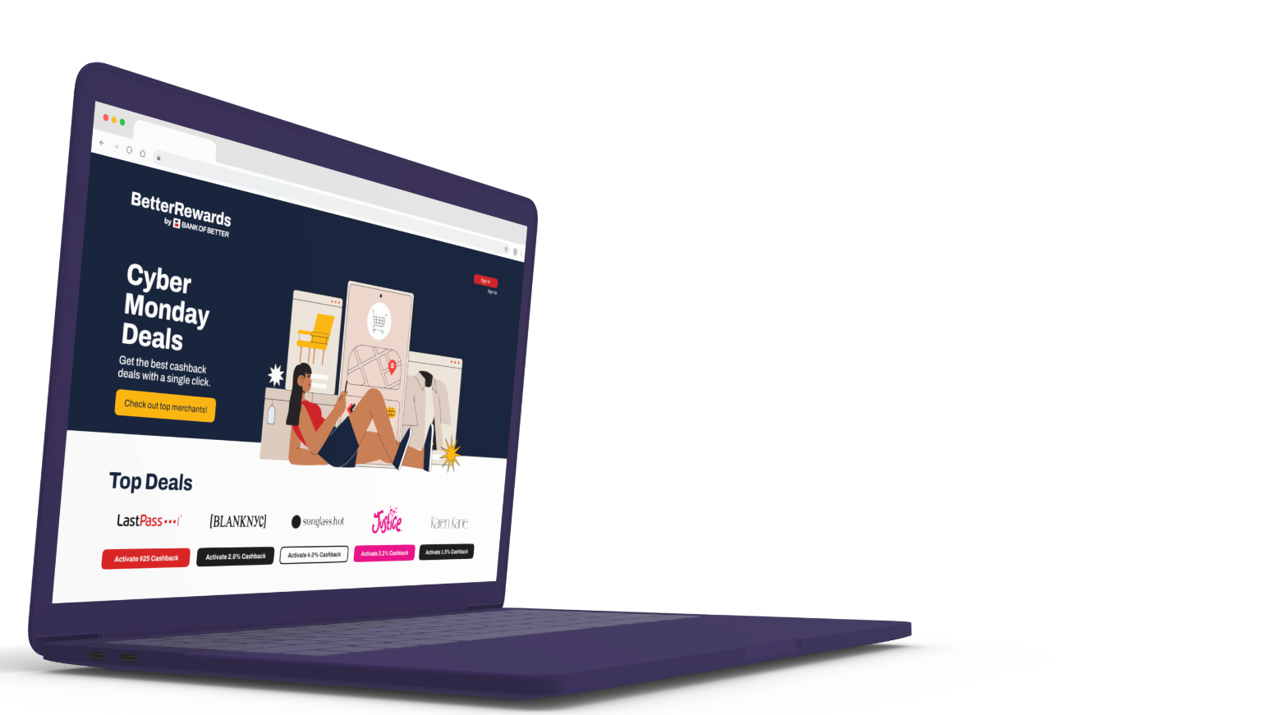

Citi QA Q1 Report
Notes:
current colors

Slide 2
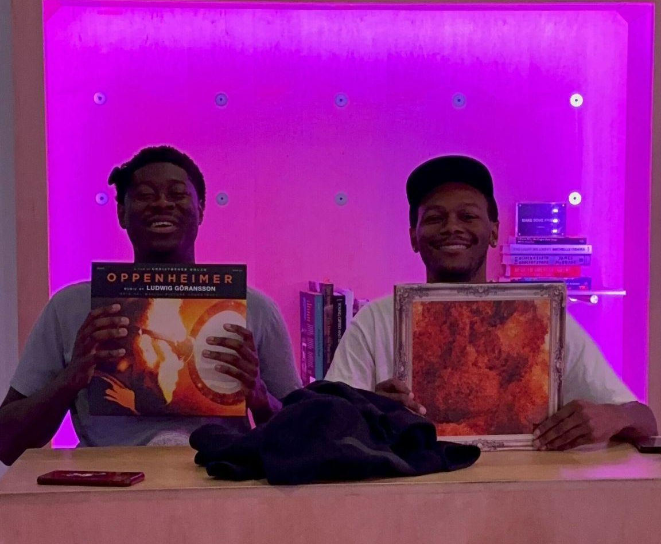
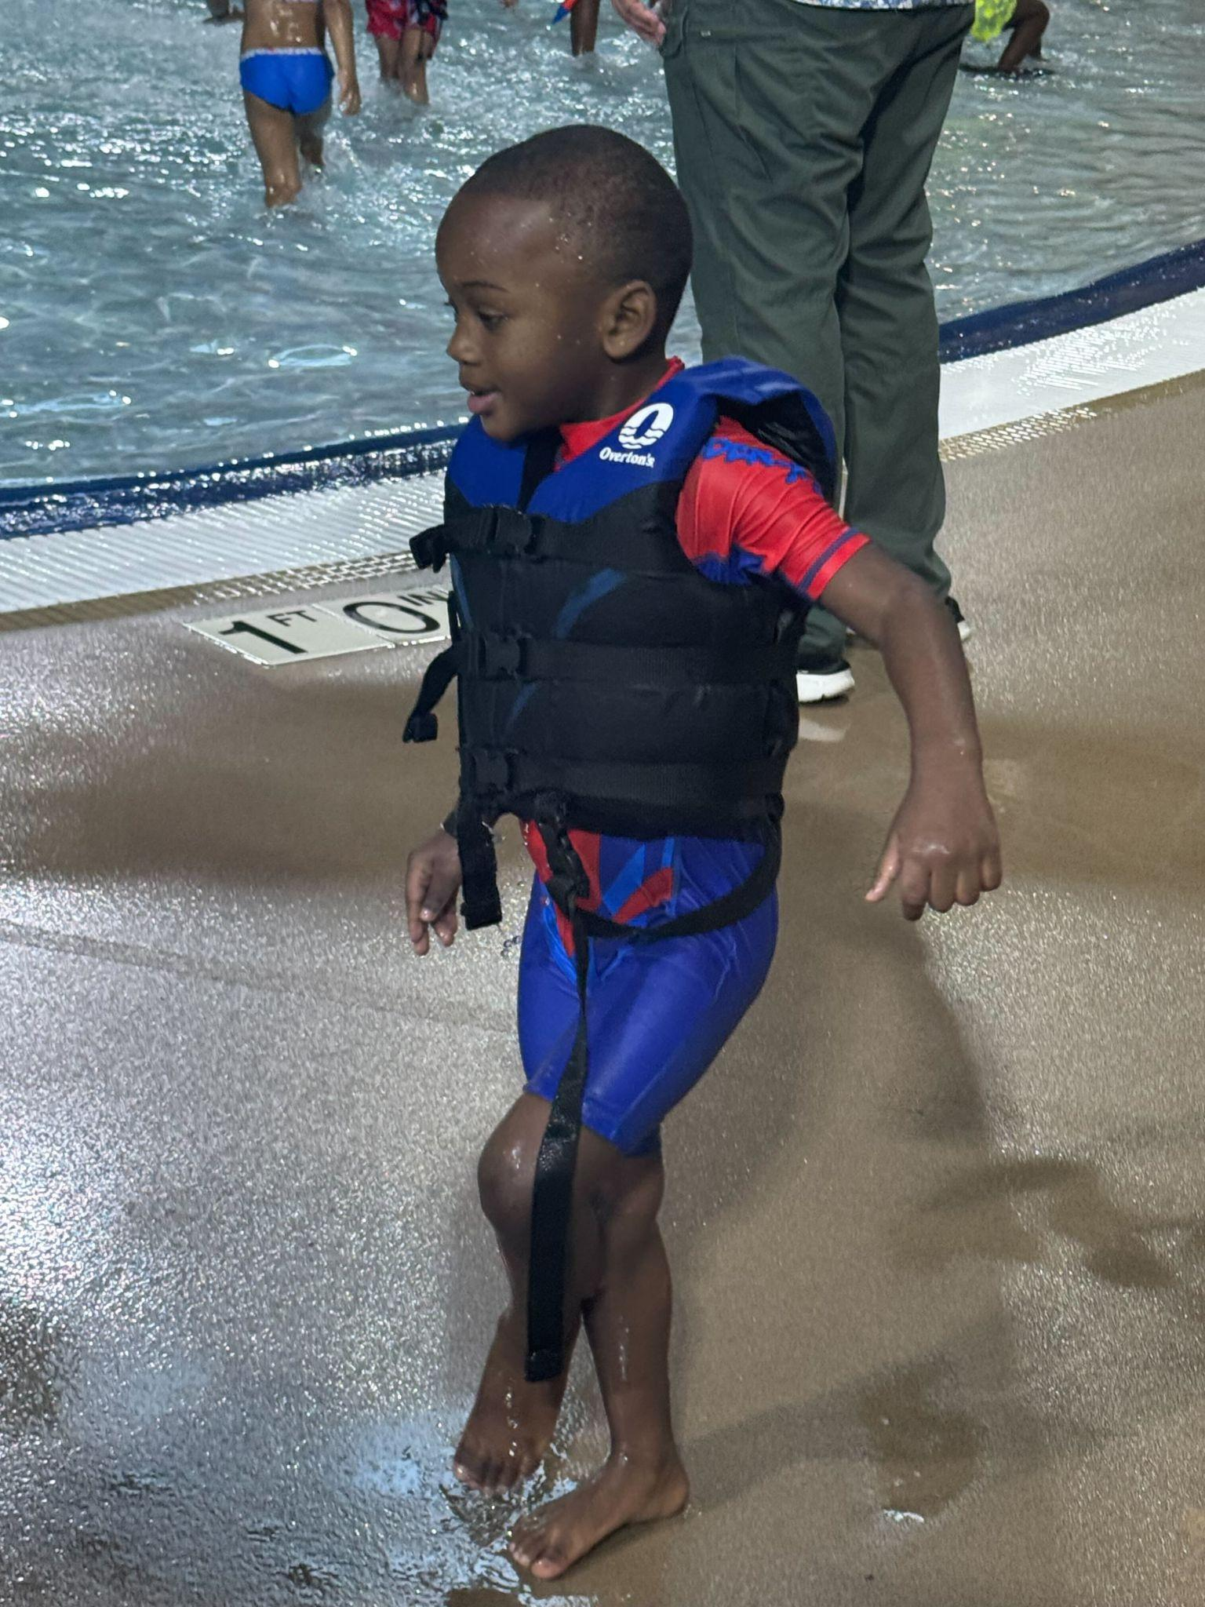
About Me!
Neil Jones
QA Analyst
POSITION
Winston-Salem, NC
LOCATION
🍿🏋🏻‍♂️🎳🎮
HOBBIES
Notes:
For emojis you can copy/paste to use in this slide, go here: https://getemoji.com/. Copy/paste the emojis you want and change the size by highlighting the emojis and adjusting the font size.

Slide 3
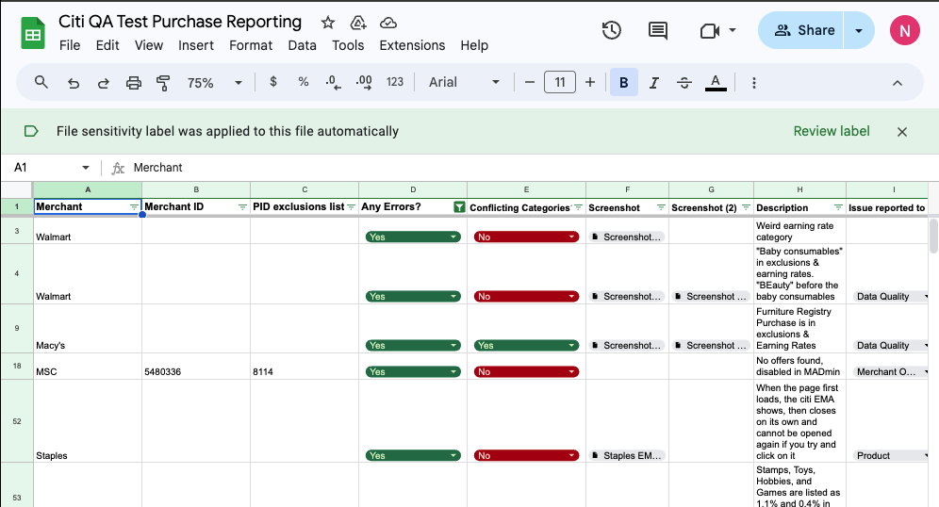
Testing document
This is where all of the testing information is stored for Citi merchant test purchases, and Monthly reports.
This test document helps identify problems so the consumer has a seamless shopping experience while using the extension.

Slide 4
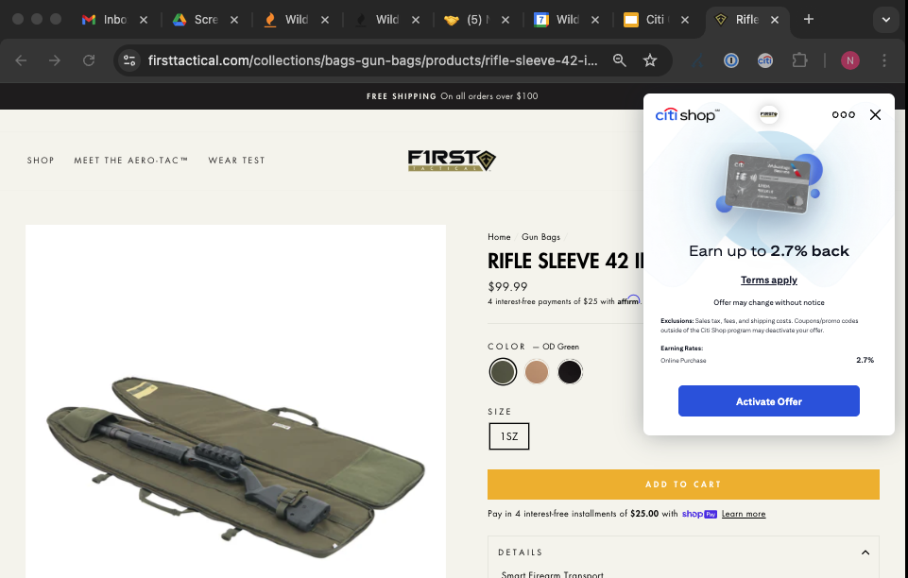
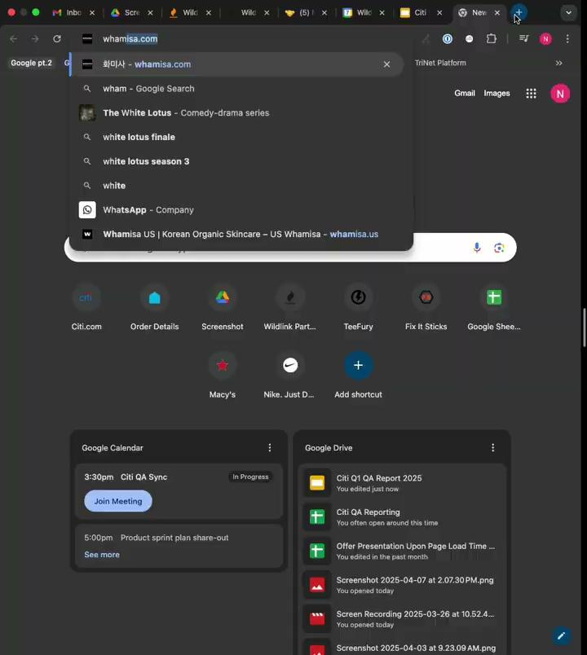
Q1 Findings
What I found in my Q1 testing was that there were merchants live in Citi that were mis-categorized. While also discovering when you press activate offer, you would be redirected to a page saying “the link is malformed”.
There were also merchants selling gun storage cases/body armor that are excluded from being able to earn through Citi.

Slide 5
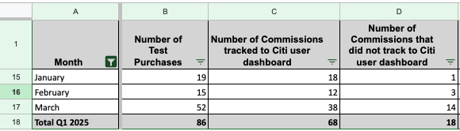
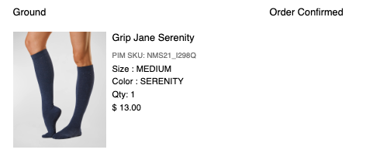
CITI Q1 Test Purchases
In Q1, I had the opportunity to place test purchases during the boosted offer campaigns in March & April to investigate if there were exclusions that needed to be added before the campaign(s) went live.
As a result of the test purchases, I was able to help add exclusions to merchants such as JCPenney and At Home. While spearheading the conversation for “In-app iOS/Android” earning rates and their inconsistency in tracking earnings for customers.
Notes:
Update merchant picture

Slide 6
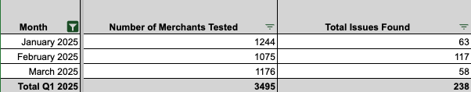
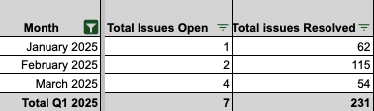
EMA Testing
Recap
In Q1, I wanted to start testing the merchants in Citi from A-Z , and targeting specific categories for merchants in Citi (Vitamins & Supplements, Lingerie, Tax Filing, etc).

Slide 7
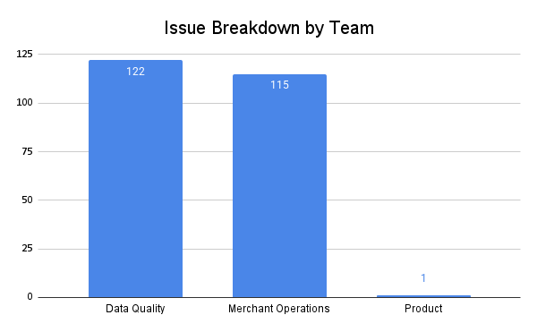

Slide 8
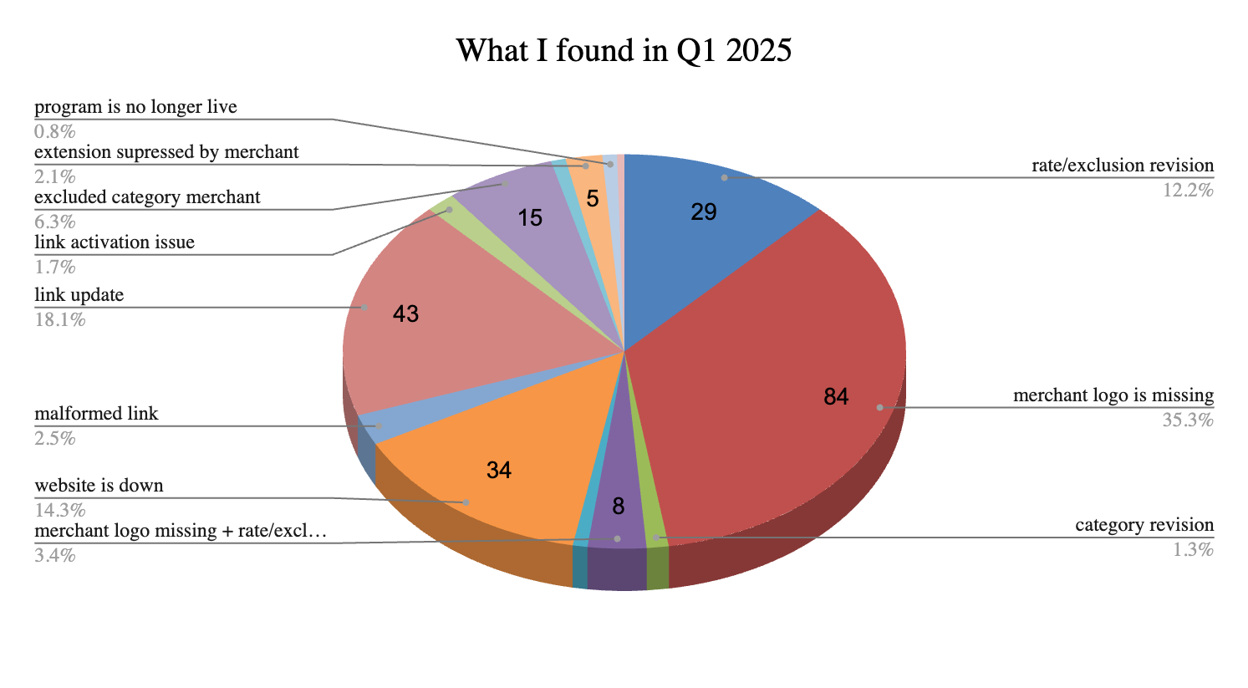
In-depth Chart

Slide 9
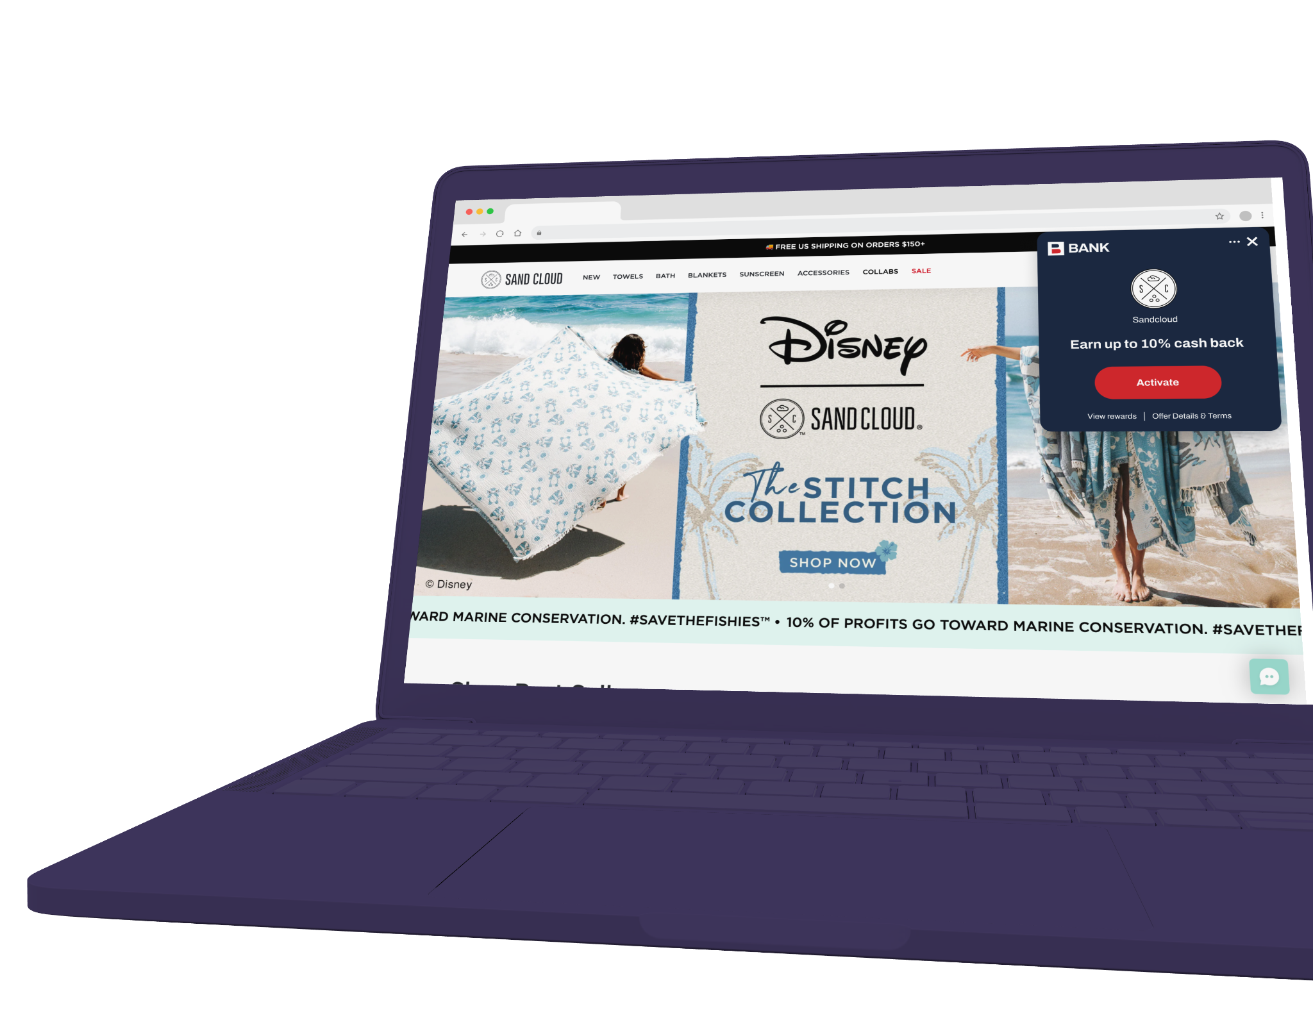
THANK YOU
Continue the conversation with neil.jones@wildfire-corp.com

